Slide 1
Research methodology MSC COURSE VALIDATING of MODELS
Sanna HÄRKÖNEN

Slide 2
LECTURE CONTENTS
Validating of models
Model BIAS and RMSE
Instructions for doing the course group work

Slide 3
VALIDATING MODELS
Important information about model’s applicability. Does it work also outside of modeling data set?
For example: leaf biomass model has been fitted with inventory data from Southern Finland. Can you apply the same model for Lappland?

Slide 4
Concept
1. Modeling data set:
Data set used for building a model
For example TREE_BIOMASS = f(height, diameter)
Checking model results: R², p-values, residuals
-> Goodness of the model in your modeling data set
2. Evaluation data set:
Another data set used for checking, if model works also elsewhere
Running the existing model with this data and comparing the model results with measured data

Slide 5
Example case
You have build a model, which estimates tree height as a function of tree diameter H= f(D). Modeling data was measured in Northern Finland.
Does it work properly in other areas? -> check with data from elsewhere. For example: apply model to calculate H for trees with Joensuu data and compare the modeled and measured values. Do the results differ those in the modeling data set? Are the differences significant?

Slide 6
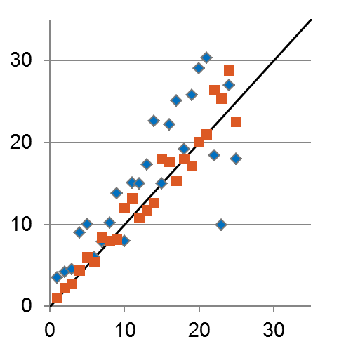
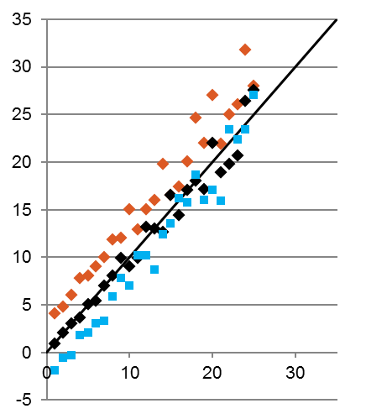
VALIDATING MODELS
Modeled
Commonly used measures:
RMSE (ROOT MEAN SQUARED ERROR)
Describes how much scatter there is between the measured and modeled values
Precision
BIAS
Describes how much the average level of the modeled values differ from the measured ones
Accuracy
Measured
Modeled
Measured

Slide 7
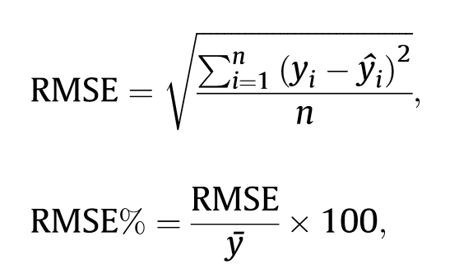
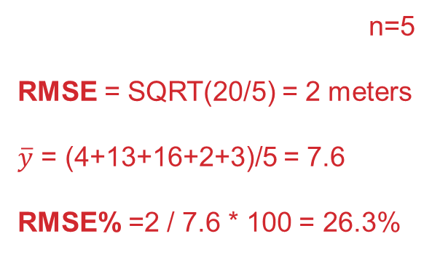
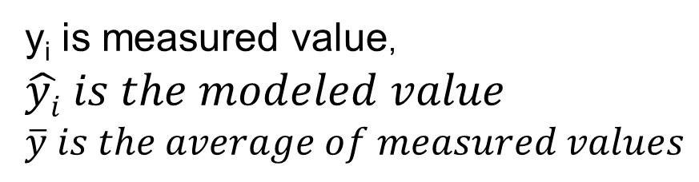
Absolute RMSE and relative RMSE (%):
MeasH | ModH | SUM((measH-modH)^2)
4 | 4 | 0
13 | 16 | 9
16 | 19 | 9
2 | 3 | 1
3 | 4 | 1
 |  | 0+9+9+1+1=20

Slide 8
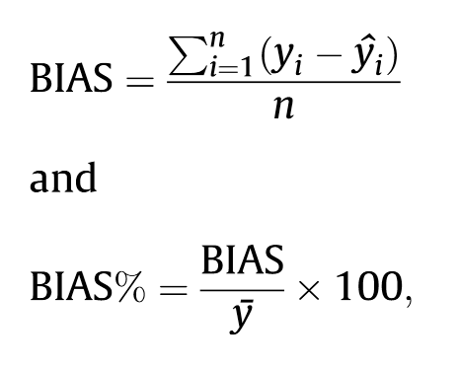
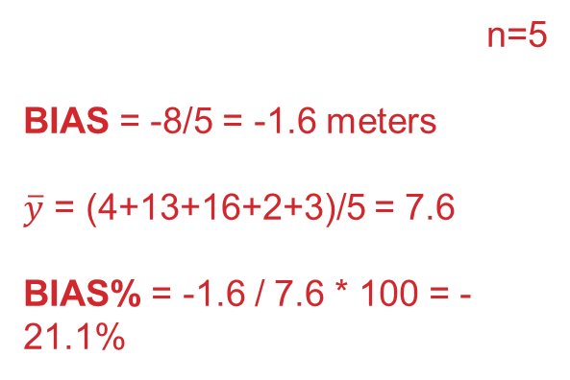
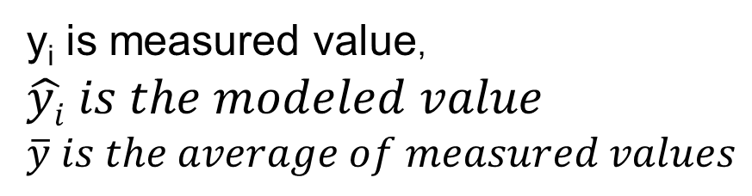
ABSOLUTE BIAS and RELATIVE BIAS%
MeasH | ModH | SUM(measH-modH)
4 | 4 | 0
13 | 16 | -3
16 | 19 | -3
2 | 3 | -1
3 | 4 | -1
 |  | 0+(-3)+(-3)+(-1)+(-1)= -8

Slide 9
BIAS AND RMSE: what do they mean?
MODEL 1:
BIAS = -1.6
RMSE = 2.0
MODEL 2:
BIAS = -1.4
RMSE = 4.7
MODEL 3:
BIAS = -7.6
RMSE = 7.9
RMSE -> how much there is scatter between the modeled and measured values. With high RMSE, model can still be unbiased (i.e. it is averagely in the same level than the measured values)
Bias -> Describes model’s tendency to systematically either over or underestimate the values

Slide 10
BIAS AND RMSE: what do they mean?
Significance of model bias?
Are the measured vs. modeled values statistically different, or is the bias just caused by random variation?
Can be tested by T-test by comparing the measured and modeled data sets together (see Blas’ lecture notes / T-test)
In R the command is: t.test(y1,y2,paired=TRUE) (y1 and y2 would be measured and modeled values in your data set, and paired=TRUE denotes that your two data sets includes data for same ”individuals”)
If T-test results (p-value) is <0.05, the bias is significant

